Slide 1
html tags
MCNDHS
Ms. Eng

Slide 2
aim: How do we create a calendar form?
Do now:
Daily Grade:
On-time/attendance/not leaving the classroom: 25%
Cellphones: 25%
Notes:25%
Classwork/Homework: 25%

Slide 3
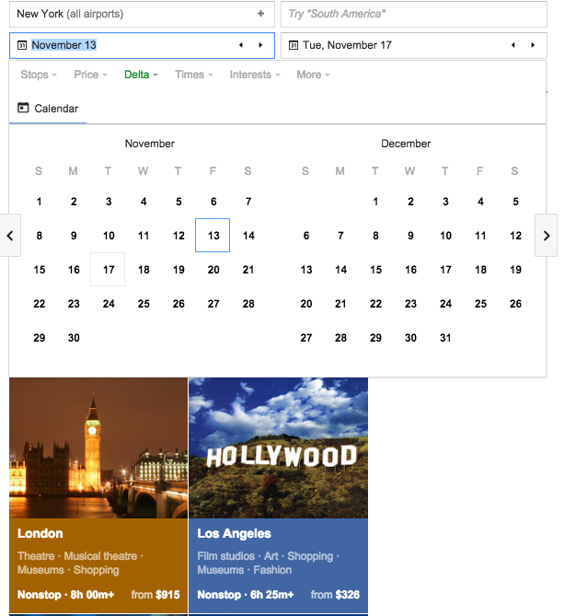
where you see it:
BOOKING :
appointments
concerts
flights
etc..

Slide 4

html tag:

Slide 5
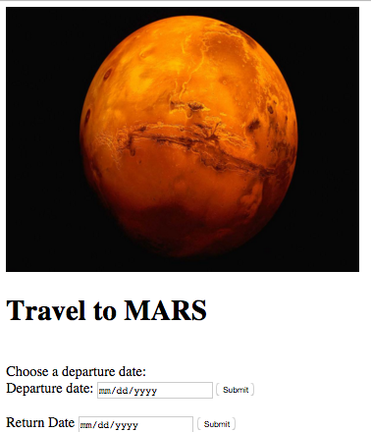
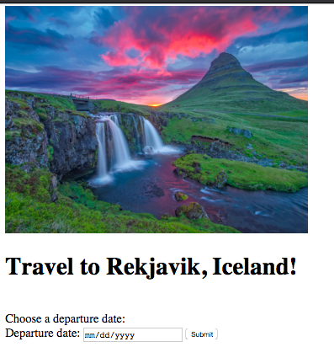
ACTIVITY

